Slide 1


Trend Analysis

Slide 2


Today's agenda
Project recap
Problem
The Analytics team
Process
Insights
Summary

Slide 3

Social Buzz has reached a massive scale within recent years and does not have resources internally to handle it.
Accenture team has taken up to support social buzz with following tasks:
-Auditing of Big Data
-Recommendations for IPO &
-Analysis of popular content.
Project Recap

Slide 4
Problem
Understanding given data sets and data model?
To identify top 5 categories with the largest popularity?

Slide 5




Mae Muligan- Managing Director
Marcus Rompton- Senior Principal
Michele Grove- Data Scientist
Surya Teja Nagamalla- Data Analyst

Slide 6
Understanding given data sets and data model.
Process
1
2
Gathering required data sets.
3
Cleaning data and preparing for data analysis.
4
Data Modelling and figuring out top 5 categories.
5
Interpreting results through visualization and presentations.

Slide 7

Insights
There are 3 datasets that were finalized for the analysis.
Out of all the columns in the datasets, I have selected important attributes like ‘Content_ID’, ‘Content Type’, Reaction’, ‘Reaction type’, ‘Sentiment’ and its related ‘Sentiment Score’.
Each Unique Content_ID has its own sentiment score and ‘content category’.

Slide 8
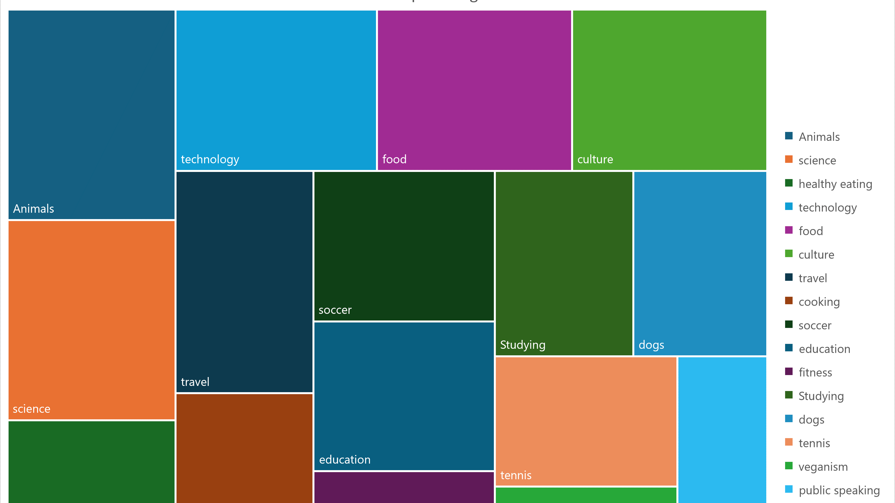
Insights:
There are a total of 16 unique content categories were present in the data set.

Slide 9
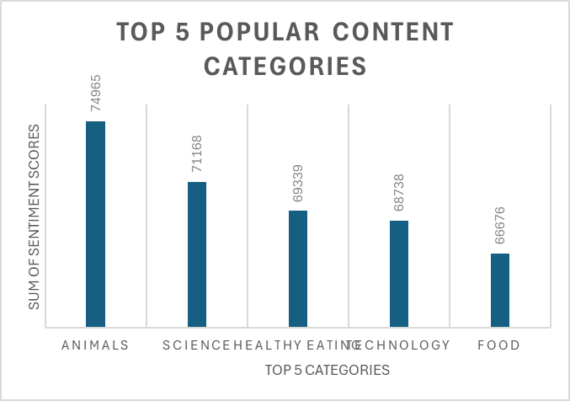
Insights
Trick: Popularity is quantified by sentiment score given to each type of category and sentiment type.so, I have aggregated the sum of all sentiment scores for each category.
Out of 16 content categories the top 5 categories that have most sentiment score are:
Animals
Science
Healthy Eating
Technology and
Food.

Slide 10
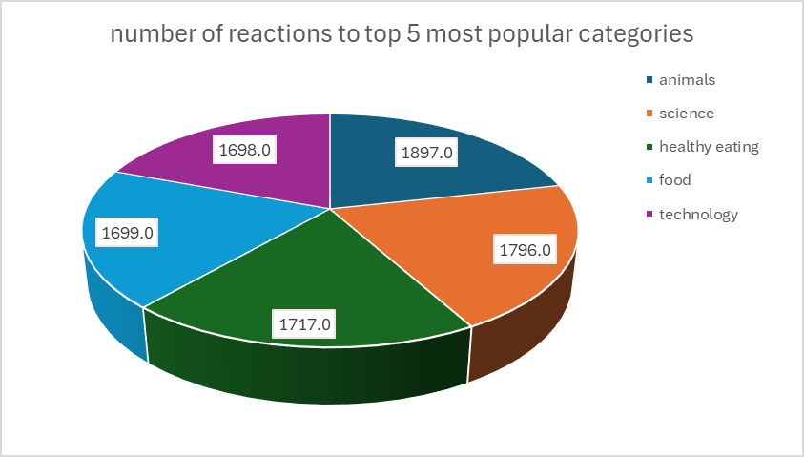
Insights
The number of reactions for most popular category “Animals” is highest compared to other popular categories.
Interestingly, technology is 4 th most popular category but is 5th top category in terms of reactions count.

Slide 11
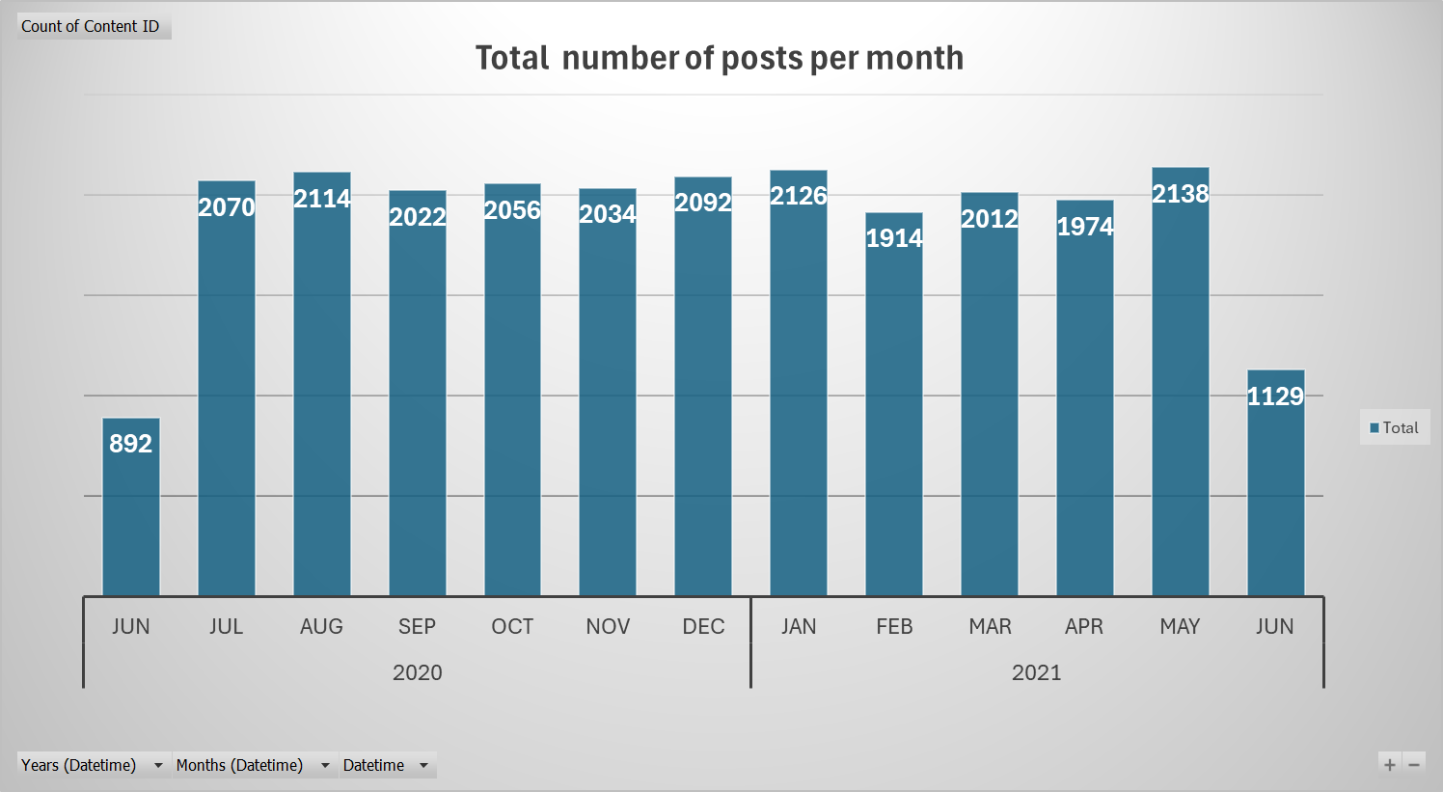
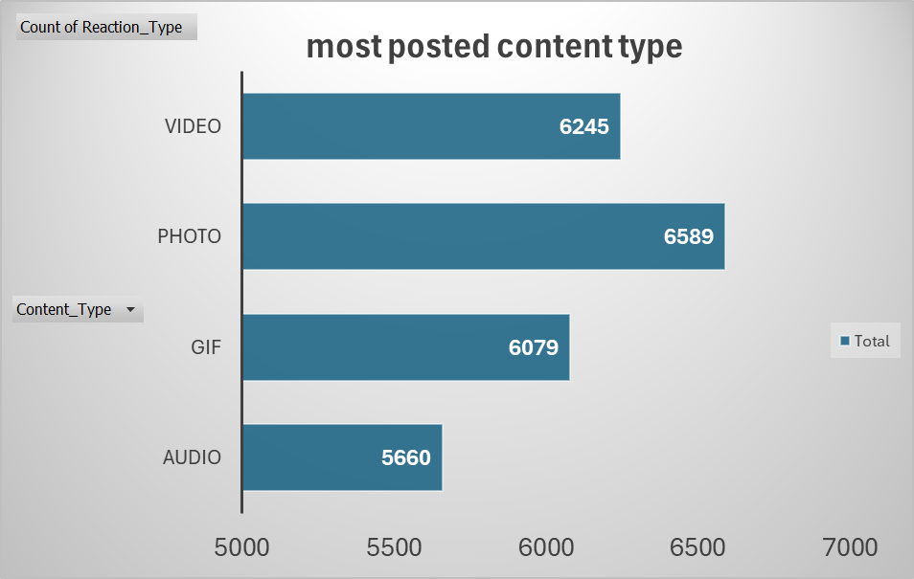
Insights:
I have found that “photos” are the most common type of media content that was posted with highest number of reactions.
Also, there has been an increase in number of postings starting from JUNE 2021 , 892 posts and has been reached a maximum in “MAY 2021” with a count of 2138 posts and suddenly declined to a count of 1129 posts in JUNE 2021.

Slide 12

Analysis:
The most engaging content on social media revolves around animals, science, and healthy eating, with food emerging as a particularly popular category.
Insights:
Use this case study to create a social media campaign that highlights the popular themes of animals, science, and healthy eating. Collaborate with science & technology companies and healthy eating brands to promote content that drives user engagement. This approach will leverage the universal appeal of these categories to build a strong, interactive community.
Next Steps:
This ad-hoc analysis provides valuable insights, but it's time to scale it for real-time business understanding. We can guide you in every step in taking this analysis into large-scale production for actionable, data-driven decision-making.
Summary

Slide 13
Thank you!
ANY QUESTIONS?

